Slide 1
Hotel Marketing Campaign
By: Mohammed Kuzhimbadath

Slide 2
Data Pre-Processing & Cleaning
During the Data Pre-Processing stage I found 2 anomalies in the data:
The ‘Date’ column had two different formats – yyyy/mm/dd & dd/mm/yyyy. Hence, I converted the dates to dd/mm/yyyy format in the CSV File.
Also, the ‘Date’ column : 29th February 2017 is not a valid date as 2017 was not a leap year, hence I had to remove 80 invalid entries with the same date.
The ‘Net_Room_Nights’ & ‘Net_Orders’ columns have negative values which is plausible. This can be explained by the fact that the Number of Cancelled orders can be more than the Total Number of Orders. For Eg. If the Gross orders=15, Cancelled Orders=-10, Total Orders=5, then Net no. of orders is -10+5=-5.
‘Geographic_Region’ I put into blocks as ‘New York’, ‘Los Angeles’, ‘Dallas’ and ‘Huntsville’.

Slide 3
Tools
Exploratory Data Analysis in Python
Visualizations in R & Tableau

Slide 4

Analysis & Insights

Slide 5
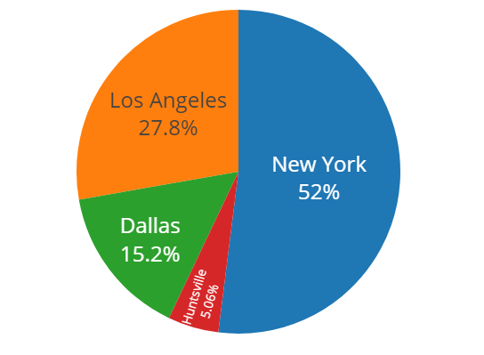
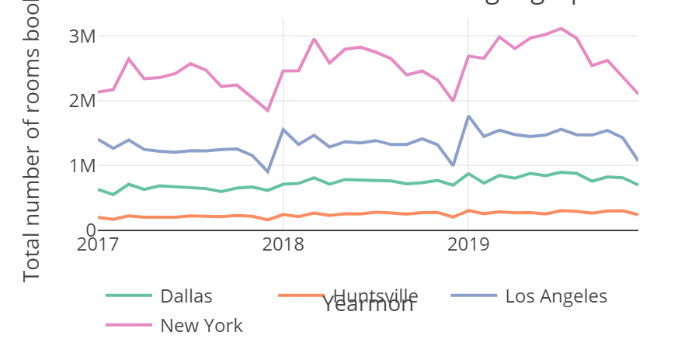
Insights 1 :
Here we can see that over time also New York has a high booking rate over time as compare to other locations. It shows a gradual increase in the bookings from 2017 to 2018. And the peak is over 3.11 mill bookings in the month of May because of summer holidays.
Also Huntsville shows almost no change over the years as it might not be a popular touristic location.
Here, we can observe that New York (52%) has the highest Net_Room_Nights, followed by Los Angeles (27.8%) , Dallas (15.2%) and Huntsville (5.06%) respectively.
This could be due to higher population in that region and a hence a higher demand for hotel bookings.

Slide 6
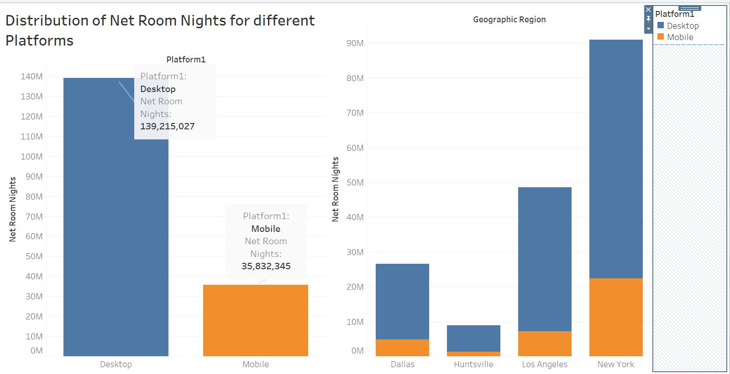
Insight 2:
Here, we can observe that for different platforms, the bookings are highest for Desktop Platform (139,215,027) as compared to Mobile Platform (35,832,345).
When this analysis is broadened and conducted over different geographic regions we find that New York has the highest Desktop and Mobile users and Huntsville has the least.

Slide 7
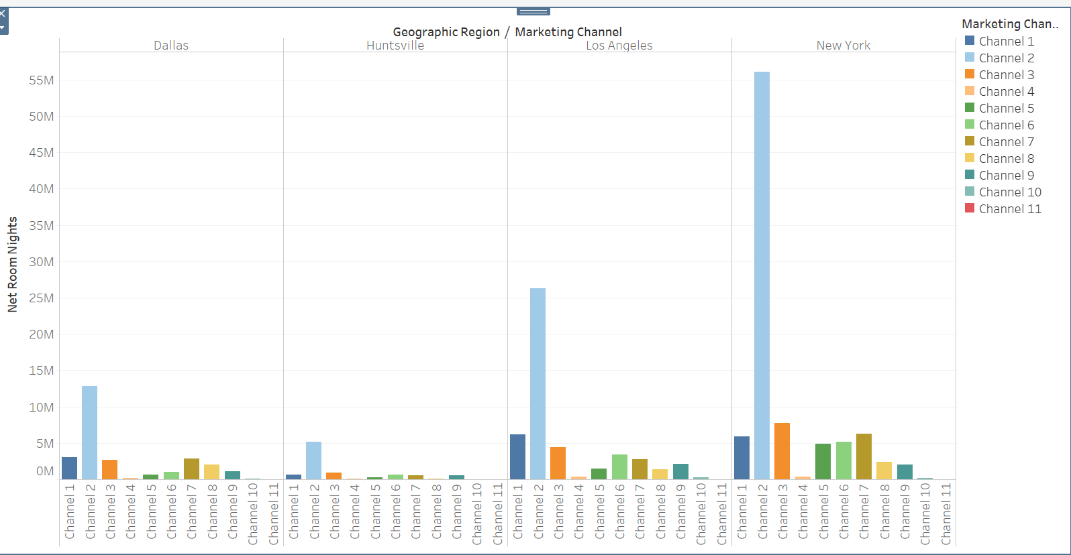
Insight 3:
Here, we can observe bookings across Geographic Region and Marketing Channels.
For New York the best Marketing Channel is Channel 2 and 3 while the worst is Channel 10.
For Dallas Channel 2 and 1 serve the best as a marketing strategy.

Slide 8
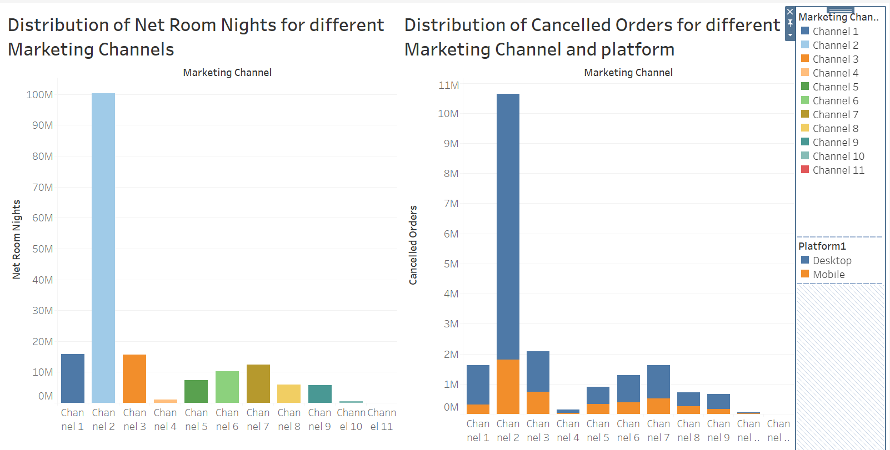
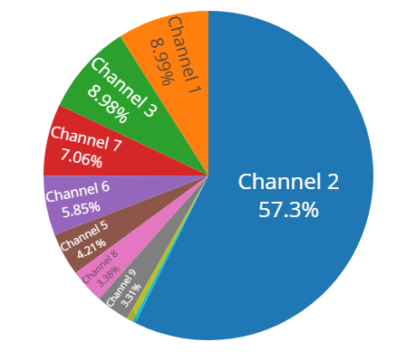
Insight 4:
Also, the Channel 2 is clearly a better marketing strategy as it bagged 57% of the customers.
Here, we can observe Net Room Nights and Cancelled Orders across different Marketing Channel.
Marketing Channel 2, 1 and 3 have the highest Cancelled Orders Especially noted among desktop Users. This might be just because the freq of Desktop Users are larger.
The bookings are marketed better to customers using Channel 2 and 1.

Slide 9
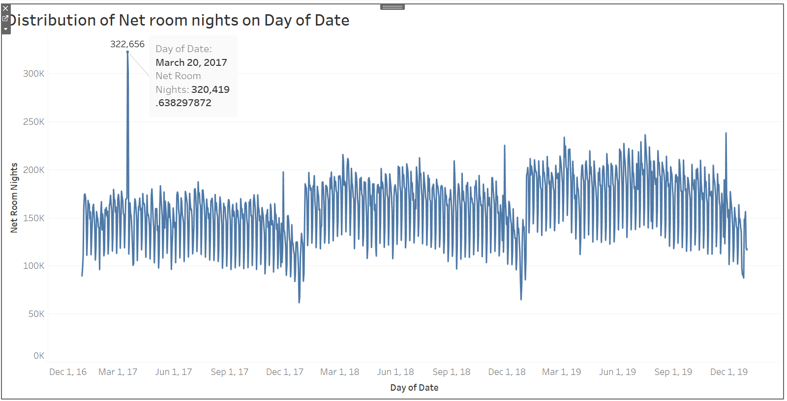
Insight 5:
Here, we can observe that it is clearly a time series model. The distribution of the Net Room Nights is a gradual increase over time. The net orders are increasing constantly from 2017 to 2019. Also, there is a spike on March 20th, 2017 probably due to a conference or social gathering event held by the hotels. Also, we cam observe that the summer months of May to July have a slight increase in hotel bookings while the months of September to December see a gradual decline in bookings due to holiday seasonal bookings.

Slide 10
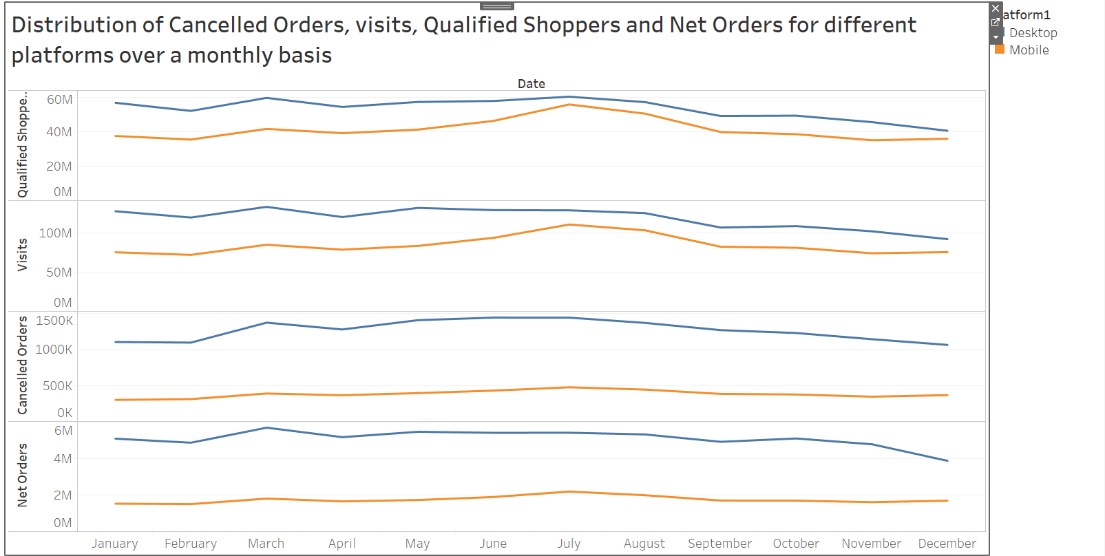
Insight 6:
Here, we can observe that this time series model has a higher number of Desktop Users for all the trends as compared to Mobile Users. I would like to highlight one data point of the month March, where for 133 million visits from 59 million qualified customers, only 5.7 million successful orders were made and 1.3 million were cancelled. This means for 100 times the site being visited only 1 booking is made. The trend is almost constant and peaks during the first half of the year while showing a slight decline over the later half.

Slide 11
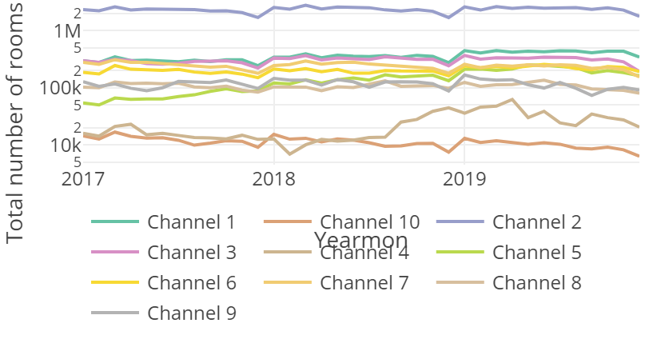
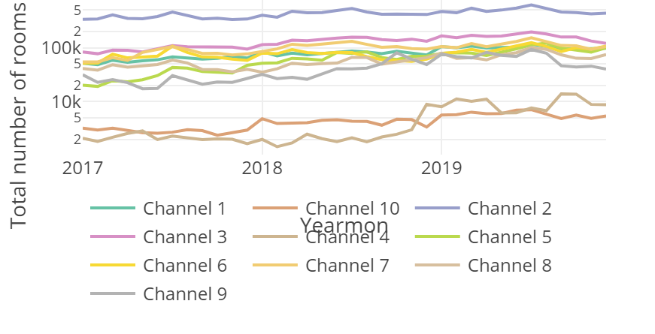
Insight 7:
Total number of rooms booked across the 10 marketing channels using desktop website.
Total number of rooms booked across the 10 marketing channels using mobile website
Here, we can observe that the desktop users are much higher and remains constant for all channels as compared to the mobile website over time. Also in Channel 10 and 4 are the least. There is an interesting reduction in room bookings from mid of 2018 from channel 10 and a surge from channel 8 in desktop website which similarly happens in the mobile website as well but towards the end of 2018. This may be due to the popular usage of this channel, due to ease of access and usage of the channel for instance Airbnb website instead of hotel bookings on google.

Slide 12
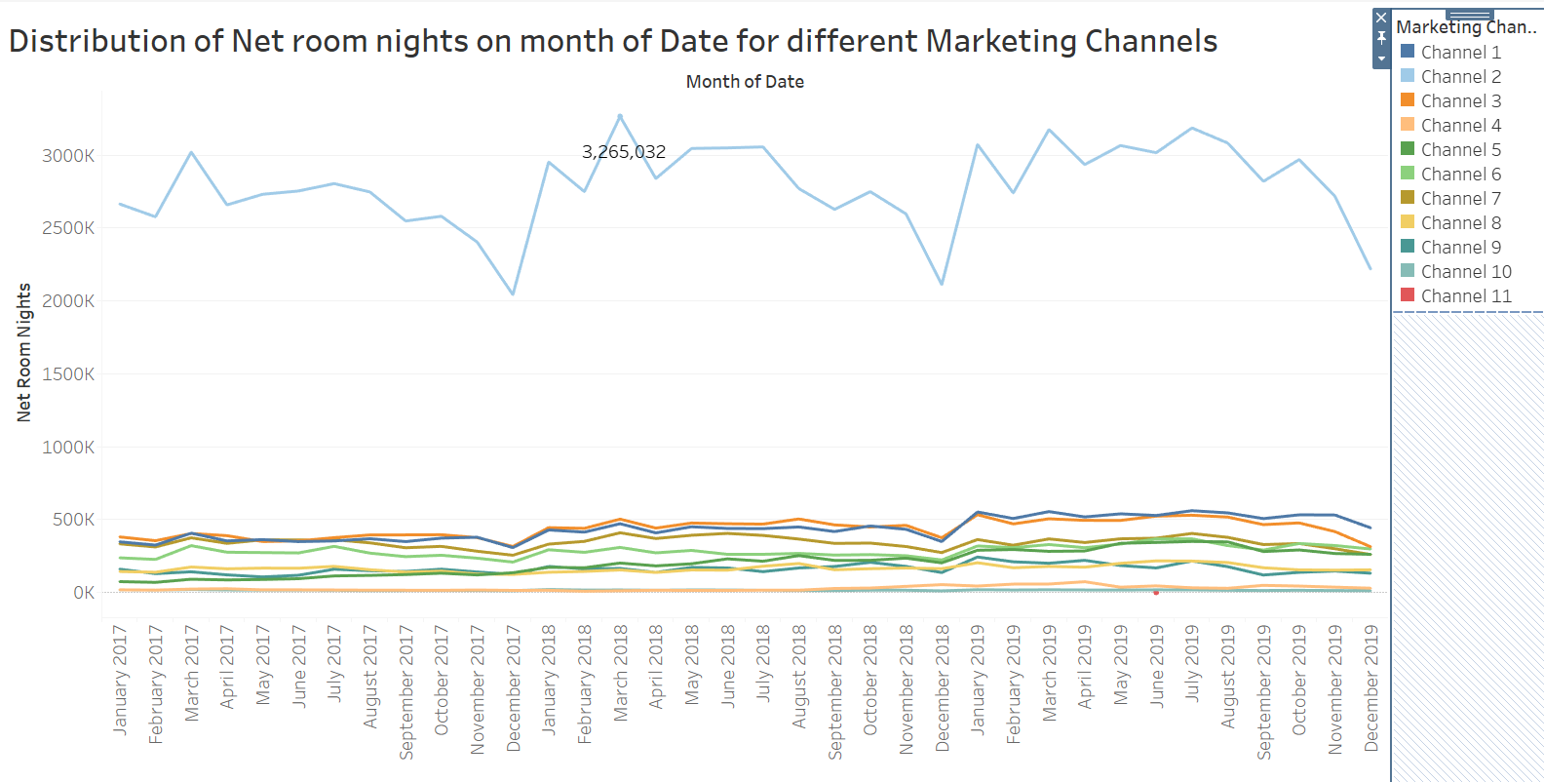
Here, we can observe that this time series model has a clearly higher number of Users from Channel 1 mode of marketing. In March 2018 the marketing channel 1 had the highest Net Room Nights of 3,265,032.

Slide 13
Final Dashboard

Slide 14
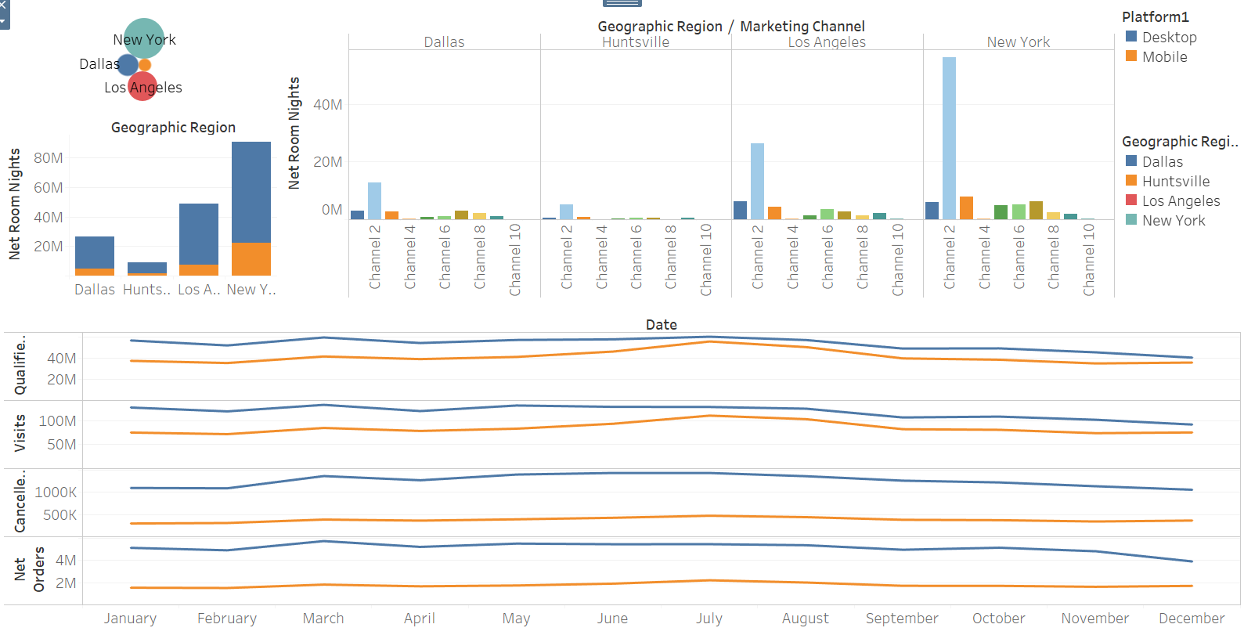

Slide 15
Summary
From the Linear Regression conducted in Python, I received a 98.87 accuracy score which means the model is excellent for predictive analysis.
Insights gathered from the Dashboards are:
New York and Los Angeles are the best target locations for marketing using Channel 2.
Also it would be better to do excessive Marketing Campaigns during the months of March, May and December as there is a surge in Bookings during the Holiday Season.
Lastly, it would be better to Target Desktop Customers and provide Desktop discounts to attract customers towards this Platform.

Slide 16
THANK YOU

